Slide 1

SonarQube
Code Quality Tool | SAST Tool
Presented By :
Amrit Choudhary

Slide 2
Pre-Requisites
Docker, docker-compose
Mac/win laptop
Github account, gitclient
Python 2.7 or 3 > installed
Jenkins & Sonarqube community version

Slide 3
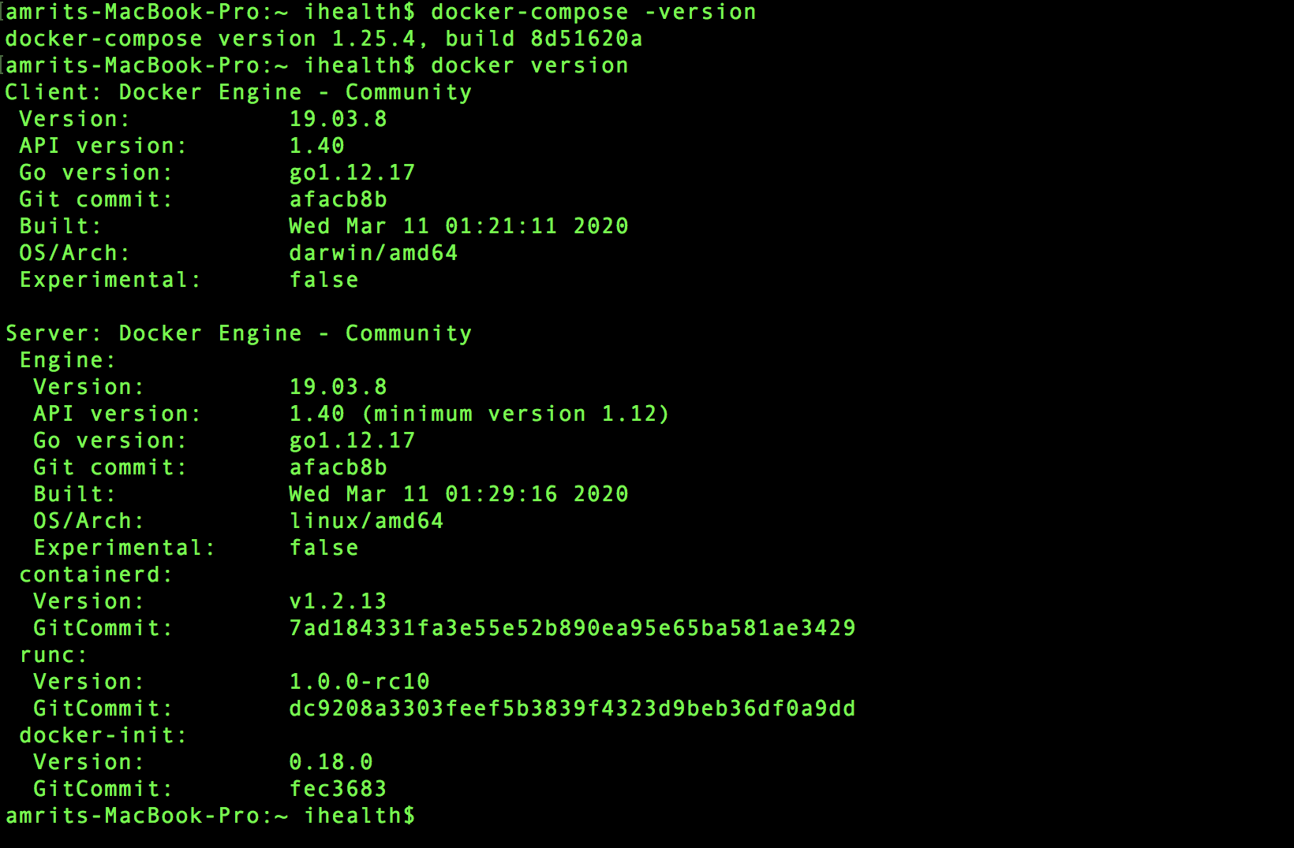
Installation Steps
Docker installation (includes engine & compose )
Mac : https://docs.docker.com/docker-for-mac/install/
Win : https://docs.docker.com/docker-for-windows/install/
Verify Docker installation
docker-compose –version
docker version

